Slide 1
SharePoint BootCamp
Robert Prüst

Slide 2
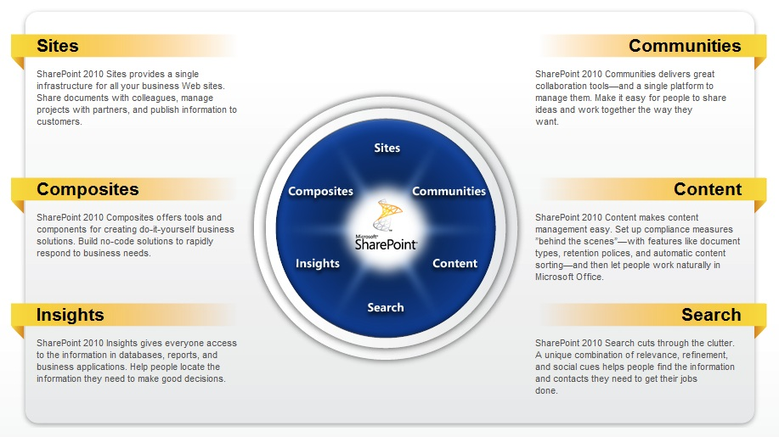
What is SharePoint?
Notes:
“Centralized place within the organization where you can upload/download files and do file management”
Key words are: Collaboration, document management, content management, centralized portal
=================================
You create a Site [1] to enable a Community [2].
Once you have a Community, they will share Content [3].
This Content needs to be managed, through metadata/filtering/workflows etc. .
The collaboration of content requires Search [4] to keep content easy to track.
End users will normally only use 1-4 for their normal use.
Management [Power Users] will tend to use Insights [5] options in order to make decisions for the organization. Sometimes delegation is provided to End users, but normally this is not done.
Developers will use Composites [6] to further customize the SharePoint solution.
=================================
SharePoint 2013 adds “Social”, which 2016 should expand on even further when looking at Yammer integration

Slide 3
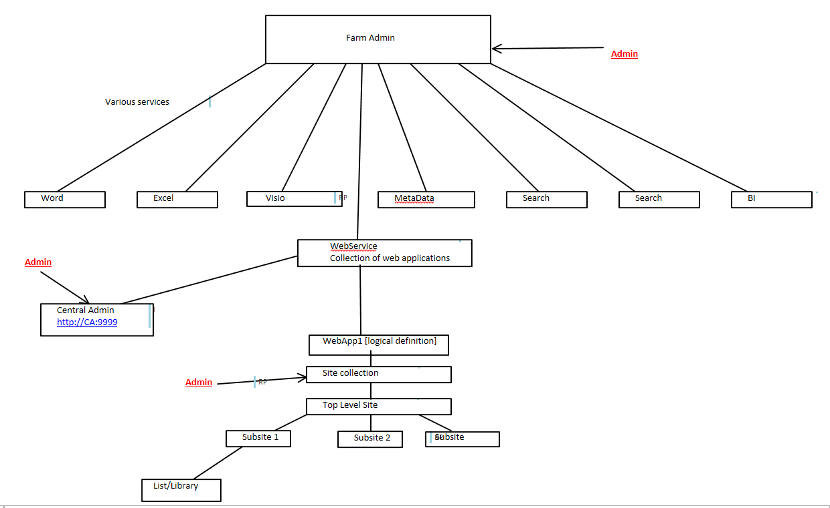
SharePoint Hierarchy – 1 Farm
Notes:
In a traditional on-premise solution, this is what your environment hierarchy looks like.
SharePoint has 3 levels of Administrators:
Farm Admins
Site Collection Admins
Site Admins
Site Collection Administrator/Sharepoint Administrator
Administrator permission to the entire Site Collection Site Owner Subsite administrator
You decide on Farm level which services you make available to the Collection, which in turn decides which of those options it makes available to the Site Admin.

Slide 4
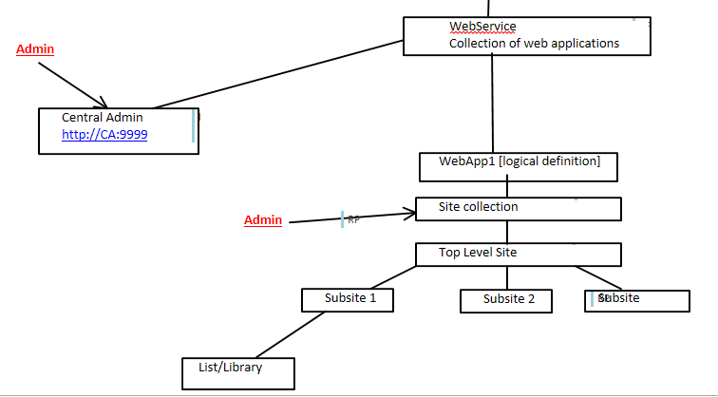
SharePoint Hierarchy – 2 O365
Notes:
In Office 365 , you basically only have access the bottom part of the hierarchy.
Site Collection admin you can access through the Tenant Sharepoint Administrator Center, while being a Site Administrator allows you extra functionality under Site Settings.

Slide 5
Demo - 1
SharePoint Admin vs Admin vs User
Notes:
==============================
*** [Show O365 portal] ***
SharePoint Admin Center
SharePoint Site Admin – Site Settings
SharePoint User – Site Settings

Slide 6
SharePoint Hierarchy – 3 What it comes down to
List: Mechanism to store data in tabular form [rows/columns]
Library: A place where you need 3rd party tool to create a document
Notes:
The 2 possible kinds of “storage” within SharePoint are List and Library, where a List would act similar to an Excel Sheet, while a Library acts similar to a File Manager.

Slide 7
Demo - 2
Lists & Libraries
Notes:
Show My List/My Library
Show Views, Tabs and Settings

Slide 8
SharePoint Permissions – 1 Groups
Owner
Member
Visitor
Notes:
SharePoint has 3 type of “out of the box” levels of permission groups:
Owner – Full control
Member – Mixed Control
Visitor – Read Only
You can create your own permission groups as per your requirements and define the required permissions for each group

Slide 9
SharePoint Permissions – 2 Levels
Site Level – 15
List/Library Level – 15
Personal Level – 3
Notes:
Permissions can be given through Permission Levels
There are 3 levels.
Looking back at the default groups, Owner has all 33 permissions defined.
By default SharePoint uses inheritance on permission levels as you are used to on a file level solution.

Slide 10
Demo - 3
Apps
Subsites
Site Collections
Notes:
Creating Apps – Users?
Creating Subsites – Site Admins
Creating Site Collections – Site Collection Admins
============================
Import Excel -> List
Add an App -> Imported Datasheet
Be sure to add the site as Trusted Site

Slide 11
SharePoint in Depth – 1 Common usage settings
Sharing
Views
List/Library Settings
Notes:
Sharing requires 2 settings to be verified:
SharePoint Admin Center -> Settings
SharePoint Admin Center -> Site Collections -> Sharing

Slide 12
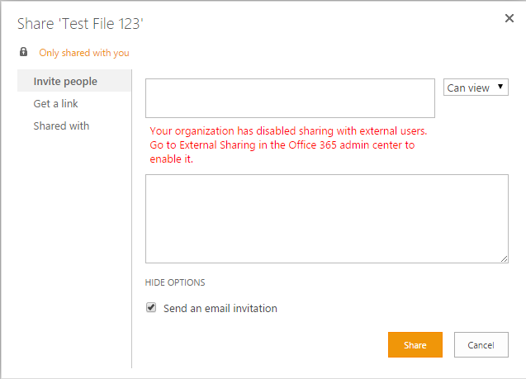
Sharing default
Notes:
Default error message when trying to share with external users

Slide 13
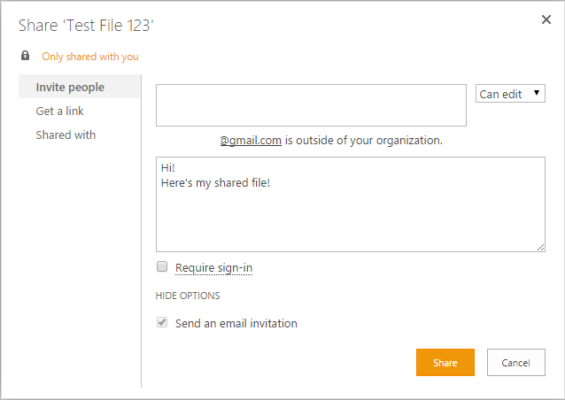
Sharing Enabled
Notes:
Once you’ve properly configured external users

Slide 14
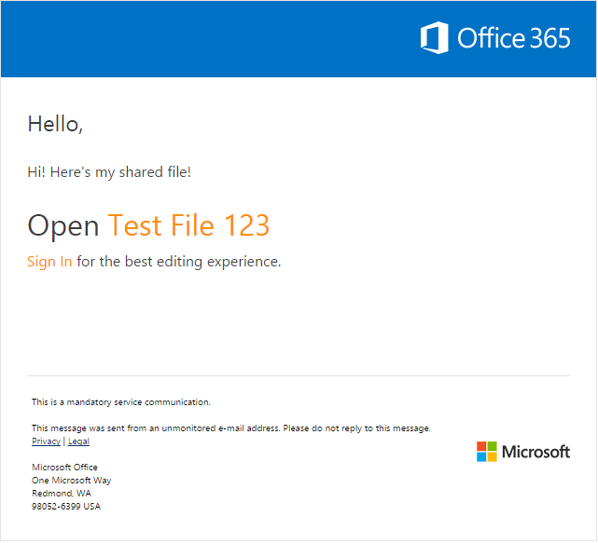
Shared File received
Notes:
Message received.
While it mentions logging in, this provides a DIFFERENT link and is NOT required

Slide 15
Views
Use Filters and Styles to display the information available in Lists & Libraries
Notes:
With views you can use filters and styles to show in different ways the information available in your lists and libraries. The truth is, there’s always a view activated in your list or library. The automatic standard view selected is normally "all items". This type of view is the basic display you are probably already familiar with.
You can even choose to have a view which removes all folders and simply displays all files within the folders.

Slide 16
Demo – 4
Views

Slide 17
List & Library Settings
Versioning
Default Column values
Advanced Settings
Creating Columns
Column Ordering

Slide 18
Demo – 5
Lists & Library Settings

Slide 19
SharePoint in Depth – 2 Think it through
MetaData/Taxonomy
Site Columns
Content Types/Content Type Sets
Notes:
MetaData is a set of data that describes and gives information about other data.
Taxonomy is the practice and science of classification of things or concepts, including the principles that underlie such classification
Site Colums is a reusable column definition, or template, that you can assign to multiple lists across multiple SharePoint sites. Site columns are useful if your organization wants to establish some consistent settings across lists and libraries..
Content Type is a reusable collection of metadata (columns), workflow, behavior, and other settings for a category of items or documents in a Microsoft SharePoint Foundation 2010 list or document library. Content types enable you to manage the settings for a category of information in a centralized, reusable way

Slide 20
Metadata/Taxonomy
Example of MetaData:
You have a device for instance Laptop
See it as “properties” of the laptop
Brand, HDD, CPU, RAM, colour, thickness, etc.
Taxonomy is the science of classifying WHAT you want to know/have available

Slide 21
Demo – 6
How they work together
Notes:
Show MetaData in Store Manager
Show Site Columns with Managed MetaData
Show Content Type - PSP
Enable Content Type on Library;

Slide 22
SharePoint in Depth – 3 Organizing
Document ID
Content Organizer
Drop Off Library
MetaData Navigation
Notes:
Document ID’s provide a single unique ID for a file, which means that you can locate this file no matter where it’s stored.
This feature is not enabled by default and needs to be enabled by the Site Collection Administrator [can take up to 24h]
=========================
Show PSP Document Ids – MEOS Documents

Slide 23
Demo – 7
Content Organizer & Drop Off Library
Notes:
This requires a Site feature – Content Organizer

Slide 24
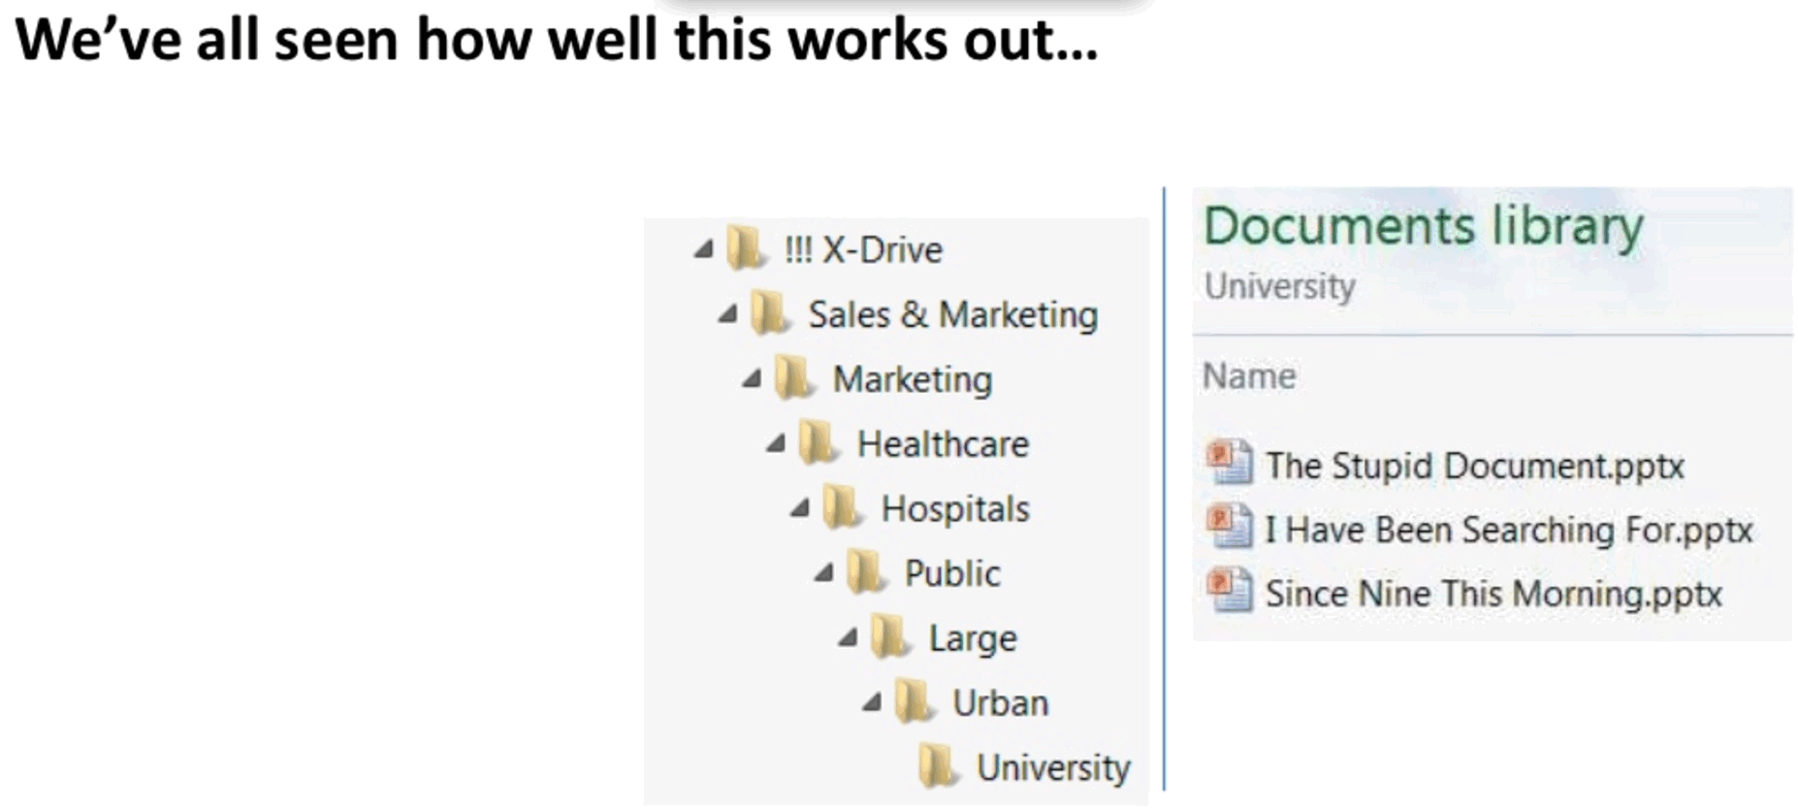

Slide 25
Demo – 8
MetaData Navigation
Notes:
This requires a Site Feature – MetaData navigation

Slide 26
Extra Info
SharePoint designer
PowerShell
Search
Notes:
Use of SharePoint designer requires a tenant wide setting to be configured, followed by 24 hours of time waiting.
PowerShell for the automation of termstore settings, configurations etc is possible, however this requires the aditional SharePoint Online Management Shell https://technet.microsoft.com/en-us/library/fp161372.aspx
You can use search portal which searches through every collection/subsite in order to provide the best details:
https://<tenantname>.sharepoint.com/search

Slide 27
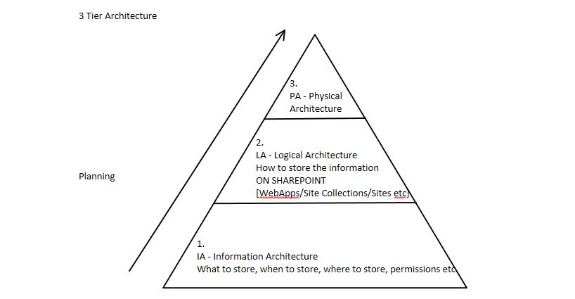
Failing to plan = planning to fail

Slide 28
Vragen??

